Slide 1




1/24
A method of hedging the price risk of
non-standardized products
——Take the chicken hedging strategy as an example
12110633 Vincent 12111808 李昊宸
12211809 梁卓均 12011901 郭希阳
12011901 郭希阳 12110629 张丁铭
12211957 孙沐妍 12310903 刘华杰

Slide 2
2/24
01
Background
02
Data
02
CONTENTS
VECM Model
03
04
Volatility Model
05
Outlook

Slide 3
3/24
PART 01
Background
第一部分

Slide 4
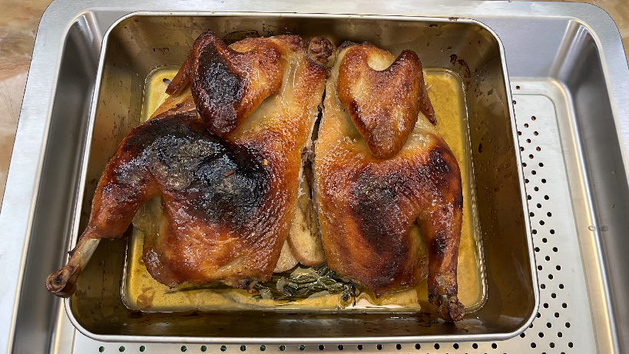
4/24
Scenario Thinking
Background
The prices of different ingredients are always changing.
You need to find some financial products to hedge your price risk.
Data
Not all ingredients have futures available for hedging.
VECM Model
Solution
The vector error correction model is used to find the long-term equilibrium relationship between the prices of non-futures products and some futures prices.
Volatility Model
Outlook
Let's explore the feasibility of this approach using chicken as an example.

Slide 5
5/24
PART 02
Data

Slide 6
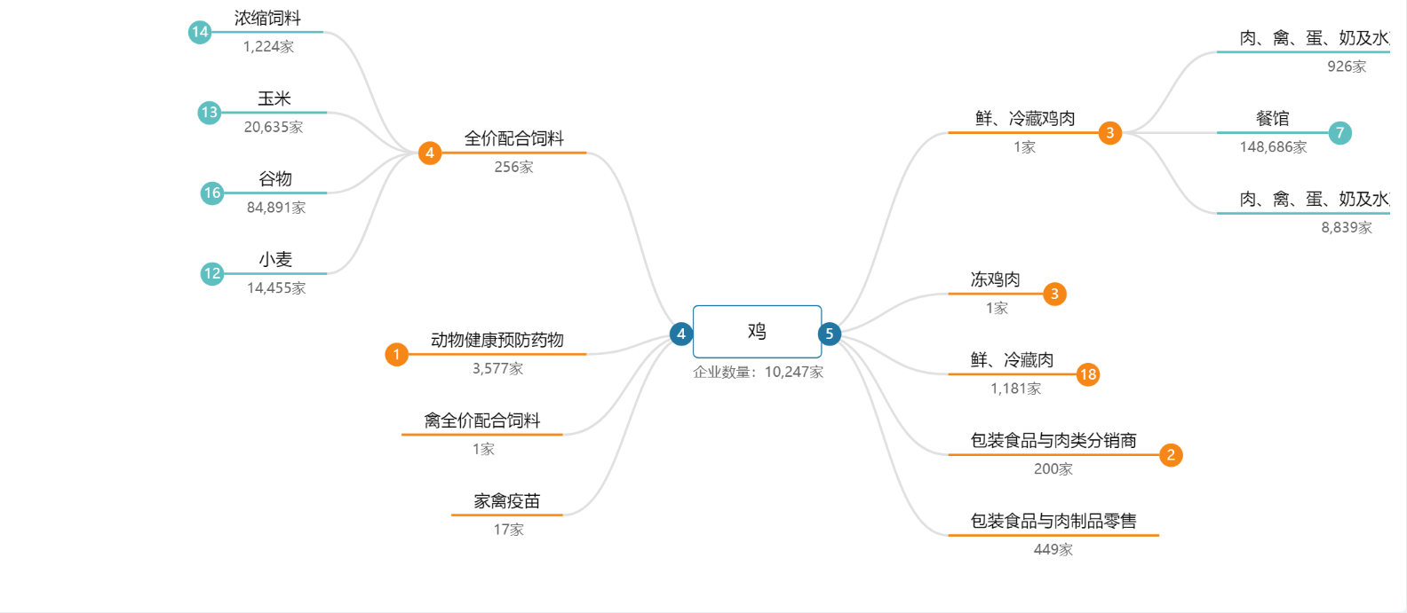
6/24
Collect data according to the industry chain
Background
Data
VECM Model
Volatility Model
Outlook
Data Source：Beijing Xinfadi

Slide 7
7/24
data unit
Background
variable | meaning | unit
chick | the chicken for eating | yuan/500g
pig | Live pig futures continuous price，LH.DCE | yuan/T
cron | Corn futures continuous price，C.DCE | yuan/T
rice | Rice futures continuous price，RR.DCE | yuan/T
bean | Soybean meal futures continuous price，M.DEC | yuan/T
t | period from 2022.01.01 to 2024.11.30 | day
肥猪 | Grade II white striped pig | yuan/500g
瘦猪 | Grade I white striped pig | yuan/500g
Data
VECM Model
Volatility Model
Outlook
"continous price" refers to continuous price of the main contract

Slide 8
8/24
Some data line plots
Background
Data
VECM Model
Live pig futures CP(continuous price)
Grade I white striped pig
Grade II white striped pig
Volatility Model
Outlook
Soybean meal futures CP
Rice futures CP
Corn futures CP

Slide 9
9/24
PART 03
VECM Model

Slide 10
10/24
DF-test
Background
variable | d_chick | d_pig | d_corn | d_rice | d_bean
p-value | 0 | 0 | 0 | 0 | 0
N | 1060 | 1060 | 1060 | 1060 | 1060
The unit root null hypothesis is significantly rejected
Data
Data after first difference, information criteria
Lag | LL | LR | df | p | FPE | AIC | HQIC | SBIC
0 | -18963.8 |  |  |  | 2.80E+09 | 35.9258 | 35.9347 | 35.9493
1 | -18819.4 | 288.87 | 25 | 0 | 2.2E+09* | 35.6996* | 35.753* | 35.8405*
2 | -18802.4 | 33.932 | 25 | 0.109 | 2.20E+09 | 35.7148 | 35.8127 | 35.9732
3 | -18782.7 | 39.403* | 25 | 0.034 | 2.30E+09 | 35.7248 | 35.8673 | 36.1007
4 | -18771.6 | 22.212 | 25 | 0.623 | 2.30E+09 | 35.7511 | 35.9382 | 36.2445
VECM Model
Volatility Model
Var，granger-test
There is a clear substitution between chickens and pigs in the short term.
However, short-term changes in feed do not affect chicken prices very much, and chickens in the market have obvious price stickiness.
Equation/Excluded | d_chick | d_bean | d_rice | d_cron | d_pig
d_chick |  | 0.648 | 0.031** | 0.399 | 0.086*
d_bean | 0.625 |  | 0.411 | 0.5 | 0.281
d_rice | 0.162 | 0.833 |  | 0.348 | 0.342
d_cron | 0.146 | 0.75 | 0.459 |  | 0.569
d_pig | 0.034** | 0.834 | 0.374 | 0.843
Outlook

Slide 11
11/24
Construct VECM model with original data and output
co-integration relation
Background
co-integration relation | chick= | 0.0002035 | *pig | + | 0.0120073 | *cron | + | 0.0149011 | *rice | - | 0.0050991 | *bean
p-value |  | 0 |  |  | 0 |  |  | 0 |  |  | 0.001
Data
White noise test of basis
VECM Model
The basis is smooth, but not white noise, indicating that there is a cointegration relationship, but not an equilibrium relationship.
——《计量经济学》李小奈，潘文卿
BASIS：chick-chick_3
White noise test of basis |  | DF-test
Portmanteau(Q) statistic | 8648.1961 | Test statistic | -3.887
Prob > chi2(40) | 0.0000*** | p-value | 0.0021***
Volatility Model
Outlook
正则化基差分位数 | zee_basis_chick | zee_thin_pig | zee_fat_pig | zee_basis
1% | -2.3818 | -1.5276 | -1.7153 | -2.3994
5% | -1.524 | -1.2985 | -1.2354 | -1.9165
10% | -1.1918 | -1.1216 | -1.0089 | -1.4679

Slide 12
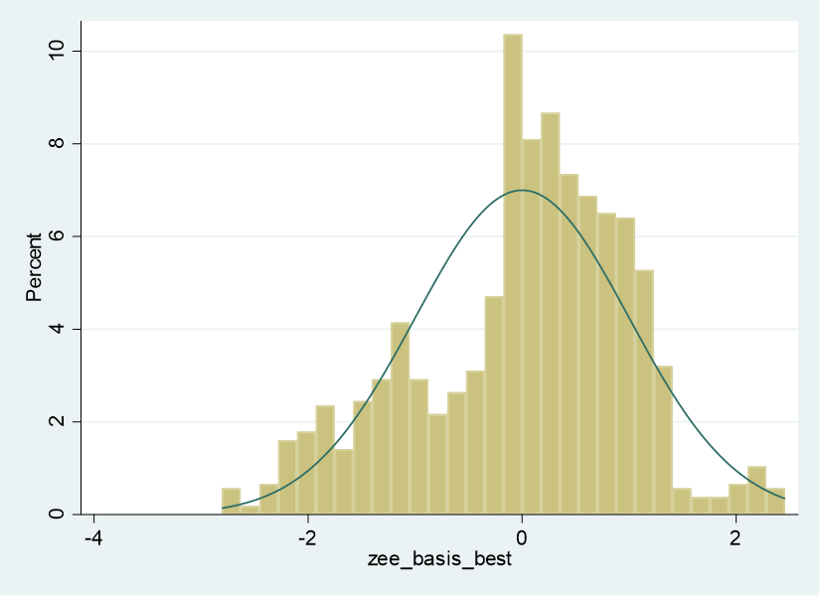
12/24
The basis is not white noise
thin_basis
thin_basis
Background
赵小雨. (2017). 沪深300股指期货基差分析. 经营管理者·中旬刊, 2017(05).
Data
VECM Model
chick_basis
best_basis
Volatility Model
Outlook

Slide 13
13/24
PART 04
Volatility Model

Slide 14
14/24
GARCH-test
Background
Garch-test | H0:no arch effect
 | bean | rice | corn | wheat
p-value | 0 | 0 | 0 | 0
Data
All the original data have ARCH effect
BDS-test
VECM Model
 | dimension |  |  |  | dimension |  |  |  | dimension |  |  |  | dimension
bean | 2 | 3 |  | rice | 2 | 3 |  | corn | 2 | 3 |  | wheat | 2 | 3
p-value | 0 | 0 |  | p-value | 0 | 0 |  | p-value | 0 | 0 |  | p-value | 0 | 0
Volatility Model
Outlook

Slide 15
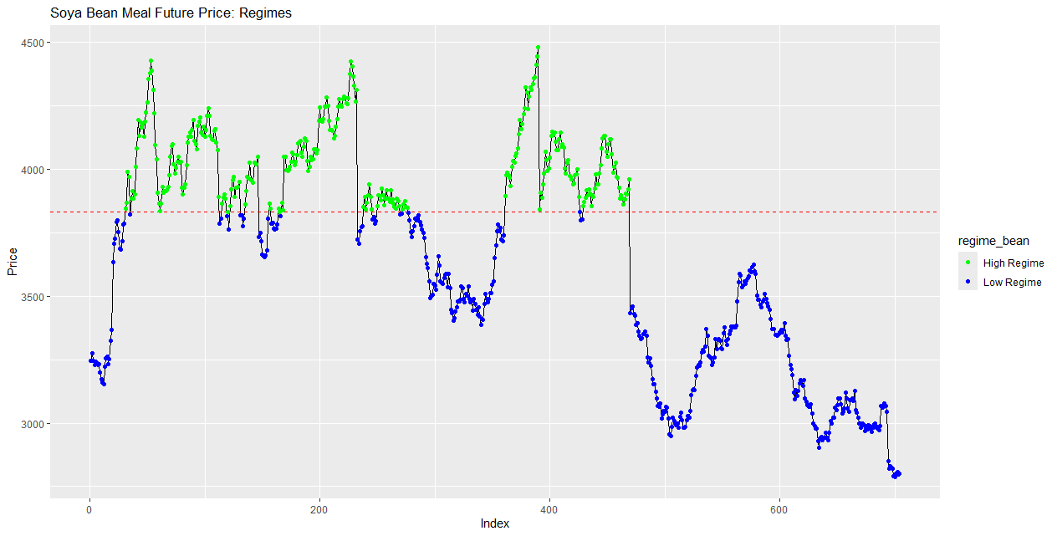
15/24
SETAR-test
Background
bean | p-value |  |  | rice | p-value |  |  | corn | p-value |  |  | wheat | p-value
m | 1vs2 | 1vs3 |  | m | 1vs2 | 1vs3 |  | m | 1vs2 | 1vs3 |  | m | 1vs2 | 1vs3
2 | 0 | 0 |  | 2 | 0 | 0.2 |  | 2 | 0.1 | 0.3 |  | 2 | 0 | 0
3 | 0 | 0.2 |  | 3 | 0.3 | 0.2 |  | 3 | 0.4 | 0.7 |  | 3 | 0 | 0
4 | 0 | 0.2 |  | 4 | 0.4 | 0.5 |  | 4 | 0.5 | 0.8 |  | 4 | 0 | 0
5 | 0 | 0.1 |  | 5 | 0.2 | 0.4 |  | 5 | 0.5 | 0.9 |  | 5 | 0 | 0
Data
Fit the SETAR Model
VECM Model
bean
Coefficient | Estimate | Std. Error | t value | Pr(>|t|)
const.L | -15.43459 | 34.438432 | -0.4482 | 0.6541629
phiL.1 | 1.300687 | 0.078141 | 16.6455 | 2.20E-16 | ***
phiL.2 | -0.29564 | 0.079784 | -3.7055 | 0.0002277 | ***
const.H | 342.645925 | 88.186359 | 3.8855 | 0.0001119 | ***
phiH.1 | 0.972203 | 0.042632 | 22.8044 | 2.20E-16 | ***
phiH.2 | -0.057937 | 0.044736 | -1.2951 | 0.1957221
Volatility Model
Outlook

Slide 16
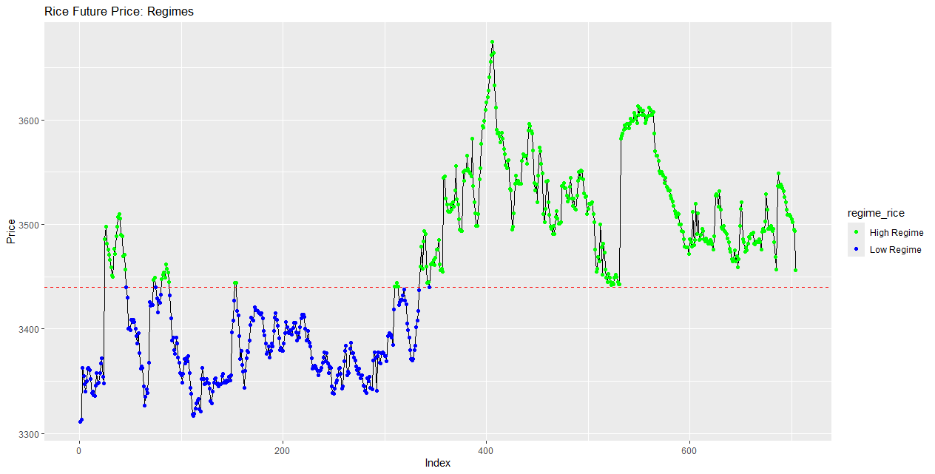
16/24
Fit the SETAR Model(Continuous)
Background
rice
Coefficient | Estimate | Std. Error | t value | Pr(>|t|)
const.L | 260.652162 | 103.12858 | 2.5274 | 0.011711 | *
phiL.1 | 1.154028 | 0.064158 | 17.9872 | < 2.2e-16 | ***
phiL.2 | -0.292712 | 0.112917 | -2.5923 | 0.009735 | **
phiL.3 | 0.1209 | 0.126667 | 0.9545 | 0.340181
phiL.4 | 0.075671 | 0.12341 | 0.6132 | 0.539967
phiL.5 | -0.134798 | 0.078978 | -1.7068 | 0.088313
const.H | 119.659073 | 53.009207 | 2.2573 | 0.024299 | *
phiH.1 | 1.023142 | 0.047289 | 21.6358 | < 2.2e-16 | ***
phiH.2 | -0.099159 | 0.065204 | -1.5208 | 0.128779
phiH.3 | 0.022802 | 0.061778 | 0.3691 | 0.712173
phiH.4 | -0.069661 | 0.061482 | -1.133 | 0.257598
phiH.5 | 0.088756 | 0.042638 | 2.0816 | 0.037744 | *
Data
VECM Model
Volatility Model
Corn futures prices fail the test, so there is no model
Outlook

Slide 17
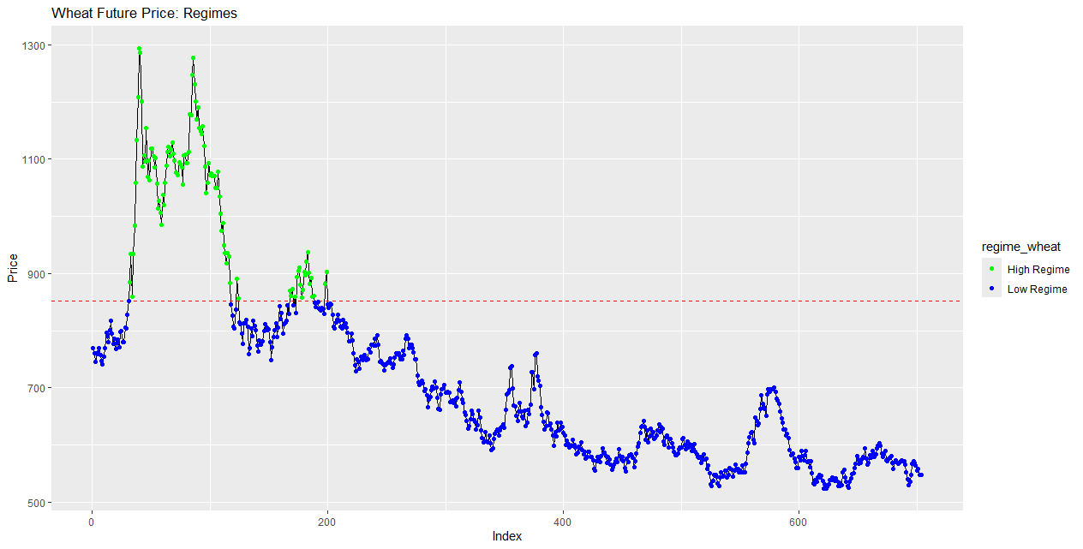
17/24
Fit the SETAR Model(Continuous)
Background
wheat
Coefficient | Estimate | Std. Error | t value | Pr(>|t|)
const.L | 1.181237 | 5.435307 | 0.2173 | 0.8280174
phiL.1 | 0.998884 | 0.055573 | 17.9744 | < 2.2e-16 ***
phiL.2 | -0.177396 | 0.080364 | -2.2074 | 0.0276108 *
phiL.3 | 0.17664 | 0.056197 | 3.1432 | 0.0017419 **
const.H | 53.216245 | 16.871151 | 3.1543 | 0.0016782 **
phiH.1 | 1.119305 | 0.049932 | 22.4168 | < 2.2e-16 ***
phiH.2 | 0.024025 | 0.074031 | 0.3245 | 0.7456393
phiH.3 | -0.195436 | 0.051432 | -3.7999 | 0.0001574 ***
Data
VECM Model
Volatility Model
Outlook

Slide 18
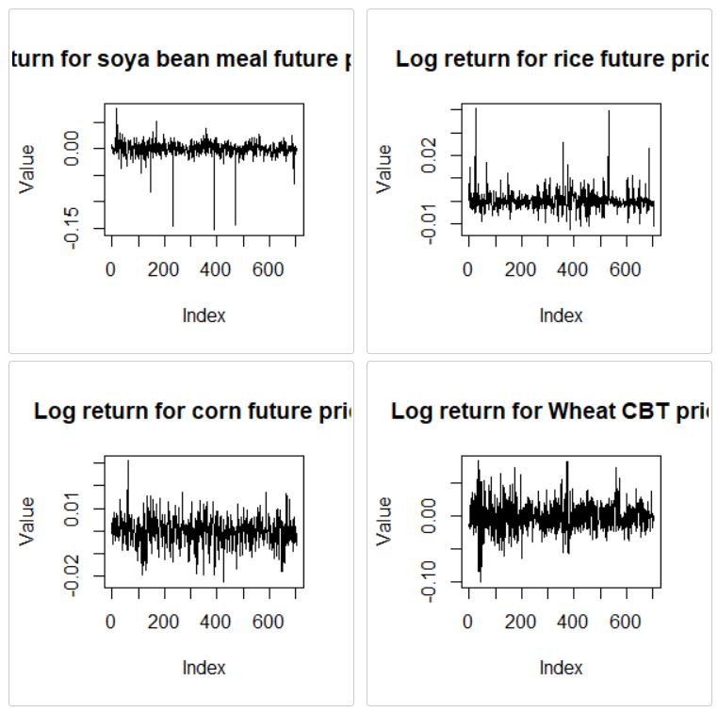
18/24
Log-return Model
Background
Data
VECM Model
Volatility Model
Outlook

Slide 19
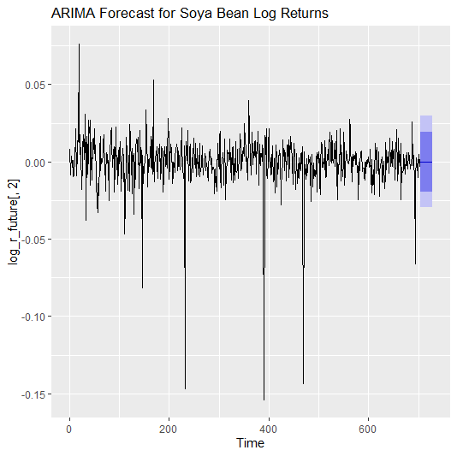
19/24
GARCH-test
Background
 | bean | rice | corn | wheat
p-value | 1 | 0.9999 | 0.0211** | 0***
Data
VECM Model
Volatility Model
Outlook

Slide 20
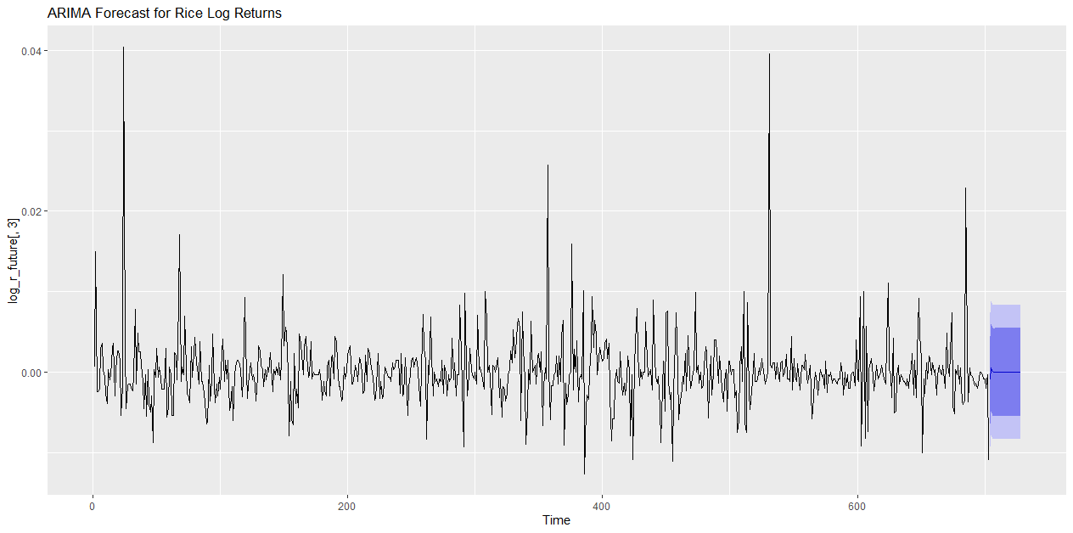
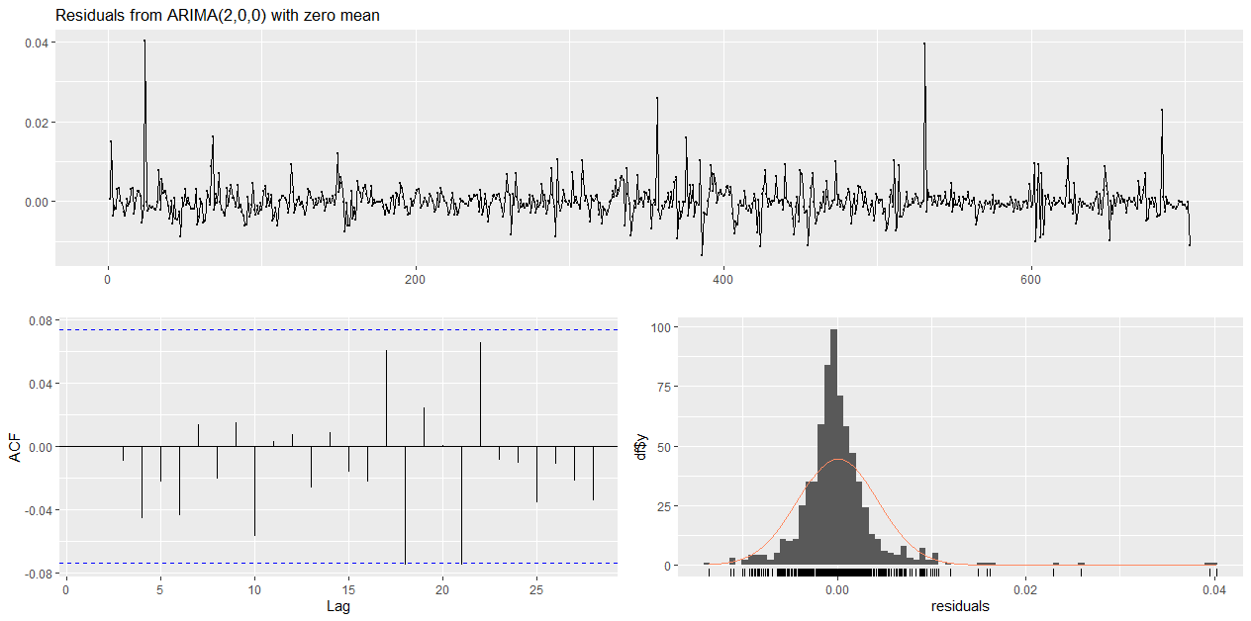
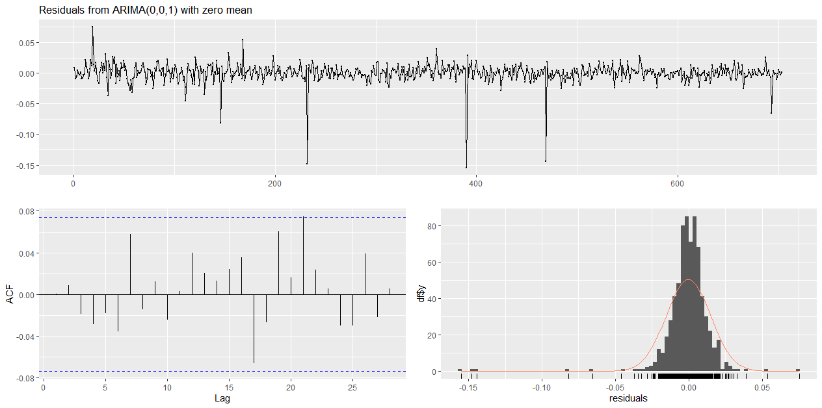
20/24
GARCH-test(Continuous)
Background
Data
VECM Model
Volatility Model
Outlook

Slide 21
21/24
GARCH-test(Continuous)
Background
 | bean | rice | corn | wheat
p-value | 1 | 0.9999 | 0.0211** | 0***
Data
The bean and rice future price are without ARCH effect, we can't build a volatility model for them.
VECM Model
Building MA(2) for bean future price and Building AR(2) for rice future price.
The expected return of both are 0.
Volatility Model
Outlook

Slide 22
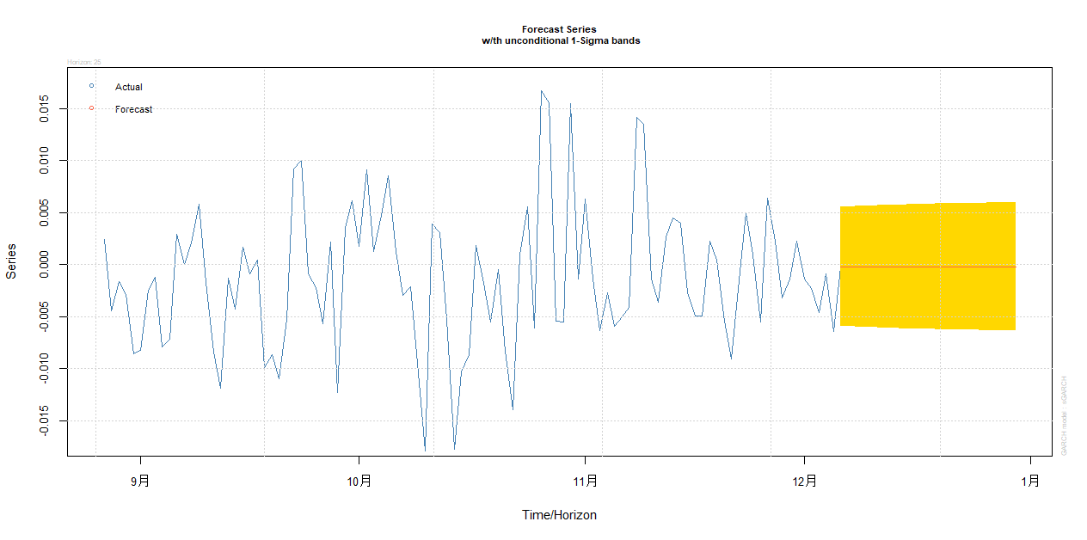
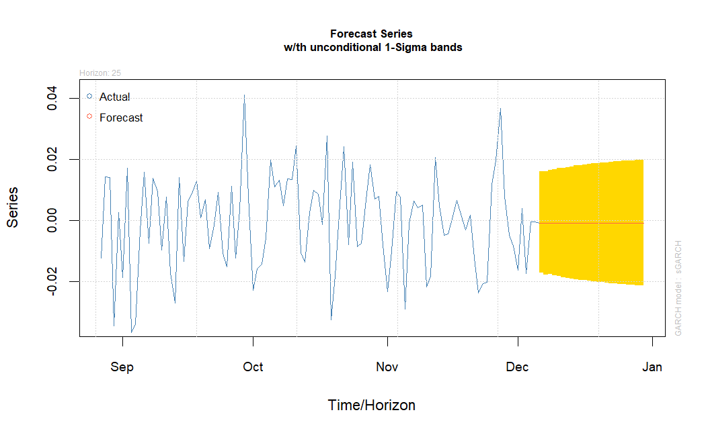
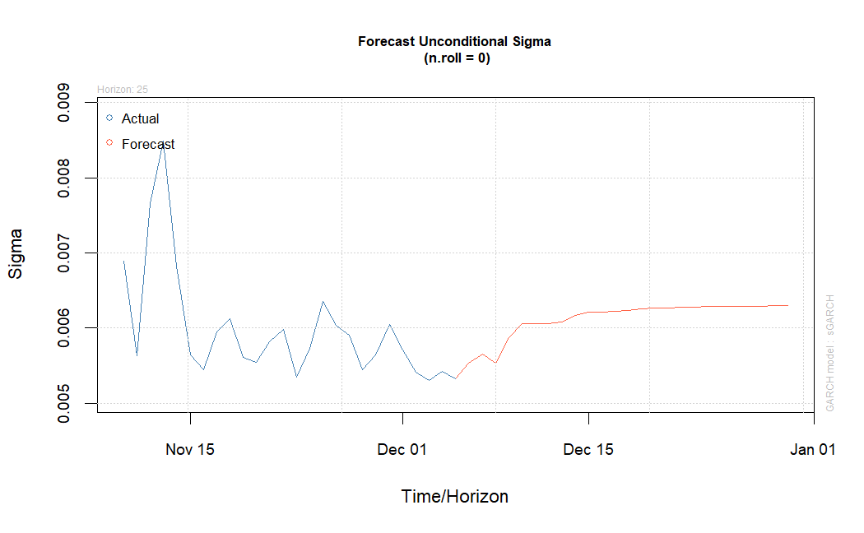
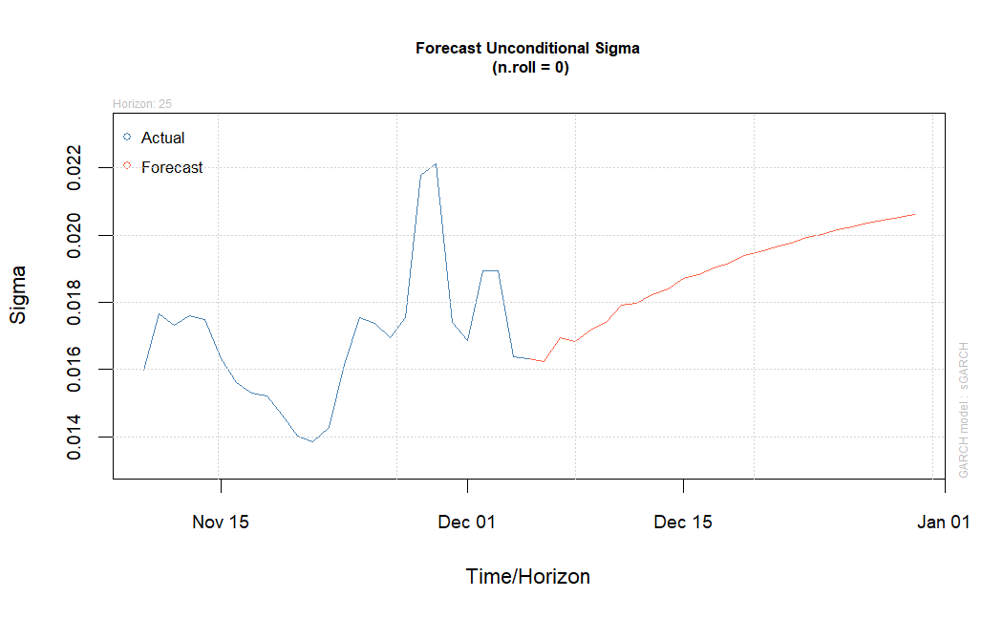
21/24
GARCH-test(Continuous)
Background
Corn log return model
Wheat log return model
Data
VECM Model
Volatility Model
Outlook

Slide 23
22/24
PART 05
Outlook

Slide 24

23/24
Outlook
Background
No equilibrium equation was found, indicating that variables were missing and the equilibrium model could not be constructed.
Data
The basis difference of extreme cases is large, and a better hedging strategy can be set through dynamic adjustment.
VECM Model
Volatility Model
Through the method of optimal asset allocation, it can be seen that the strategy has the possibility of optimization.
Outlook

Slide 25

24/24
感谢
您的观看和收听
第一部分

